Slide 1
Analysis of Threatened Species
CSA B1 Group 03 Home Assignment

Slide 2
Group Members
Rollno | NAME | GR. NO.
2 | Aahan Jain | 12010250
3 | Aarya Tiwari | 12010588
5 | Harshal Abak | 12011089
8 | Omkar Abhang | 12011406
9 | Abu Ansari | 12010599

Slide 3
Introduction
Analysis of Threatened Species of 5 different countries with a dataset given by IUCN.
Visualization and different conclusions from the graphs.
Everything done in R language.

Slide 4
Task
Dataset Acquirement
Pre-processing
Visualization
Conclusions

Slide 5
Pre-processing
Understanding what is there in different columns.
1) NA
2) Country, Region or province
3) year
4) Type of Threatened Species
5) Number of Threatened Species
6) Footnotes about different country, region or any kind of side information of the data
7) Source, by whom the information was gathered.
Dropping columns 5,6,7.
Renaming different columns and their elements appropriately.
Typecasting the appropriate values using strtoi() command (Originally, every entry in the dataset was of string datatype).
Shortlisting 5 different countries.

Slide 6
Pre-processing
In this particular analysis, we shortlisted the following countries:
1) India
2) Australia
3) United States of America
4) Bangladesh
5) Japan
After splitting, merging, cleaning of the data, we have prepared four dataframes with respect to the type of threatened species, each containing the data of the 5 countries.

Slide 7
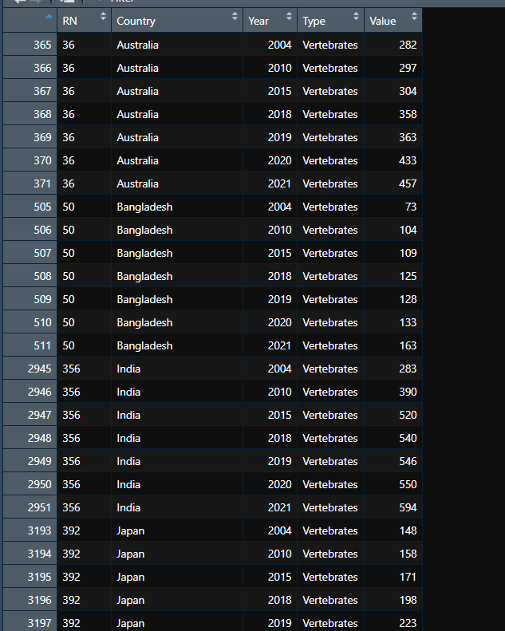
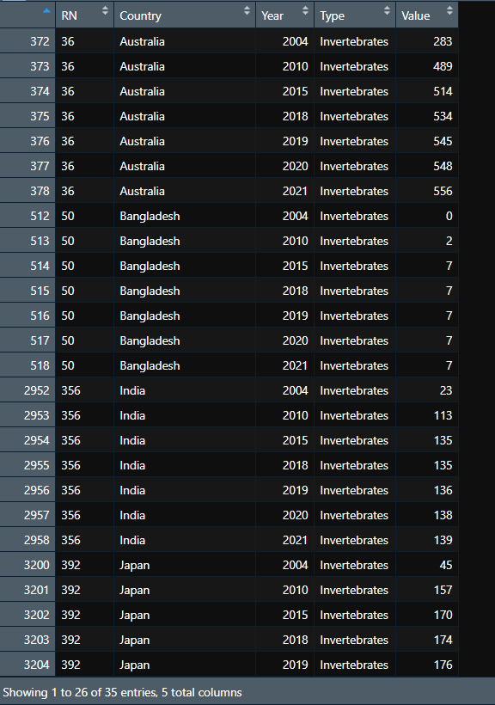
Pre-processing
This is what a portion of the metadata looks like : -

Slide 8
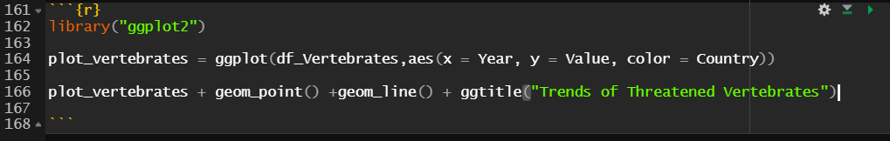
Visualization-line plots
We are going to plot line graphs and bar charts for the respective datasets.
The code snippet that does the line plotting part is :
geom_points() plots the points, geom_line() connects the points, ggtitle gives the title of the graph.

Slide 9
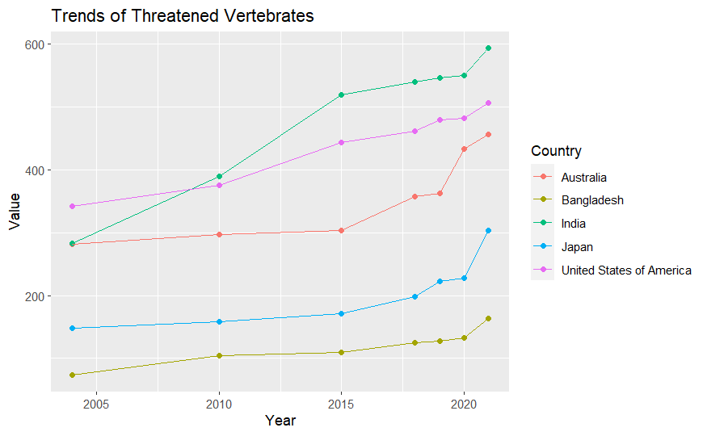
Visualization - line plots Vertebrates
Looking at the graph, we get the following
Conclusions:-
Bangladesh has the least amount of Threatened vertebrates.
India and Australia started off with the same number of threatened invertebrates, but India’s trend spiked up more.
In the year 2010, India surpassed USA with more number of threatened vertebrates.
Japan and USA follow almost the same pattern but USA’s count of value is more.

Slide 10
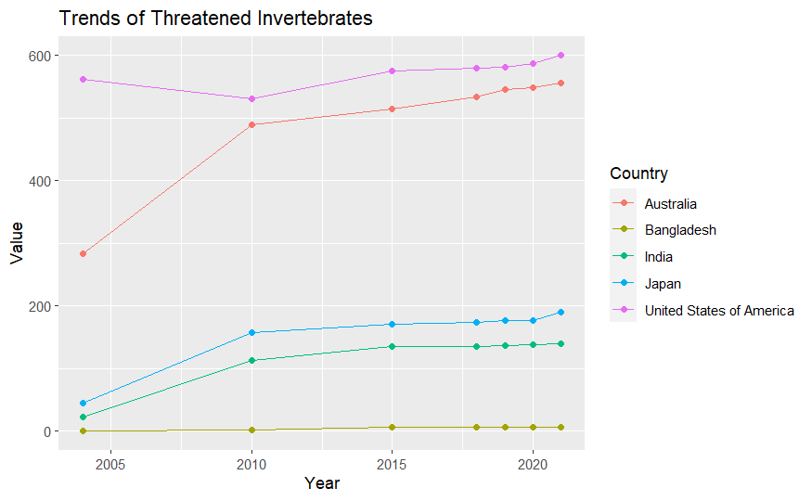
Visualization - line plots Invertebrates
Looking at this graph, we get the following
Conclusions:-
Bangladesh had no threatened invertebrates over the years.
India and Japan follow nearly the same pattern over the years, with a little difference of values.
USA has the most number of threatened invertebrates and the number varied almost linearly over the span of 17 years.
Australia’s count spiked up between 2004 and 2010.

Slide 11
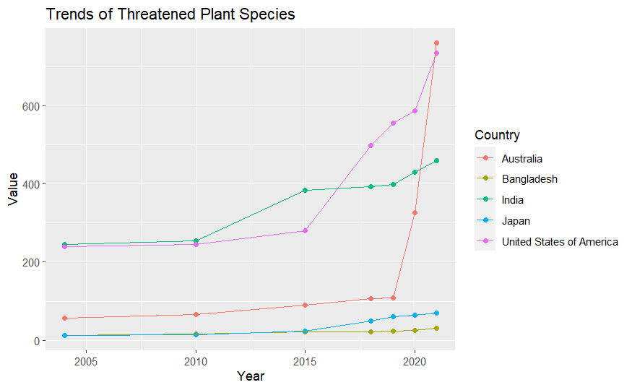
Visualization - line plots Plants
Looking at this graph, we get the following
Conclusions:-
Japan and Bangladesh had very less variations over the years.
Due to forest fires and other natural disasters, Australia’s count suddenly increased between 2019 and 2020, surpassing every other country in this subset.
USA’s count also showed a sudden increase between 2015 and 2018.

Slide 12
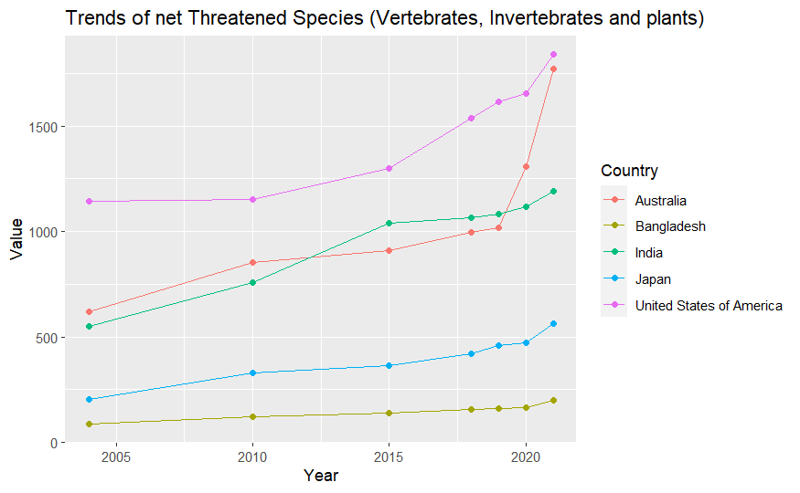
Visualization - line plots Total effect.
Looking at this graph, we get the following
Conclusions:-
Bangladesh has the least amount of variation due to less disasters and low development rate.
Australia shows sudden increases due to the disasters.

Slide 13
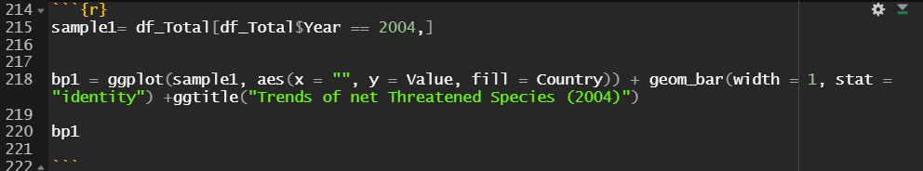
Visualization-bar plots
For comparing the amount of total threatened species in any particular year, we are going to make bar plots.
For doing that, we generate datasets on basis of years and then plot the graphs.
The code snippet that does the dataset generation and bar plotting part is :

Slide 14
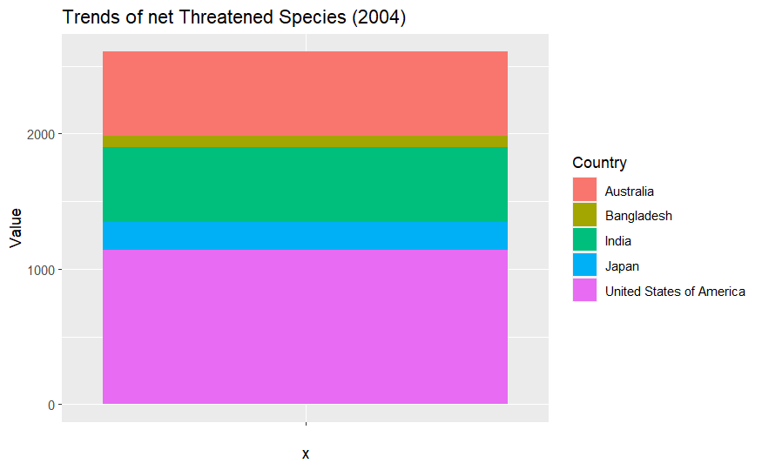
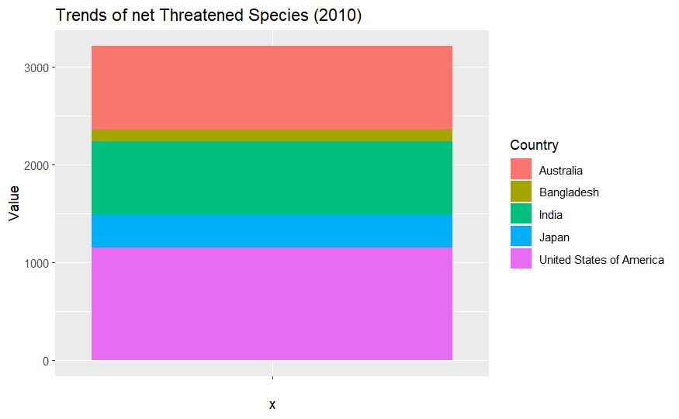
Visualization – Bar plots 2004, 2010

Slide 15
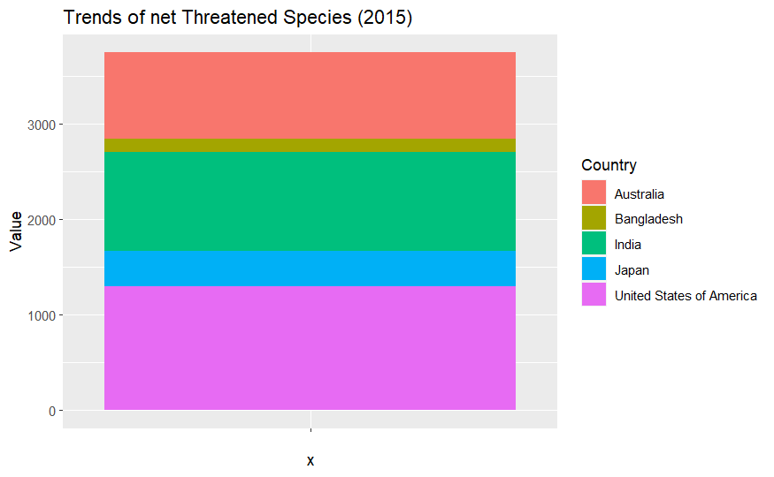
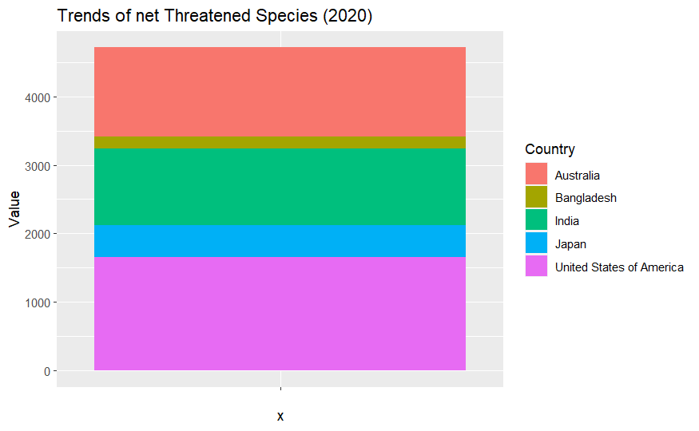
Visualization – Bar plots 2015, 2020

Slide 16
Conclusion and Final thoughts
In Bar plots, Bangladesh remains almost constant throughout.
Visible differences are seen in Australia and USA’s count.
To understand the increase in the trends, the plot of 2004 had the upper scale count to 2000, in 2020, the upper scale count is 4000.

Slide 17
Thanks!!! Any Queries?

